Slide 2
Montreal, Here and Now
Understanding the Current Context

Slide 3
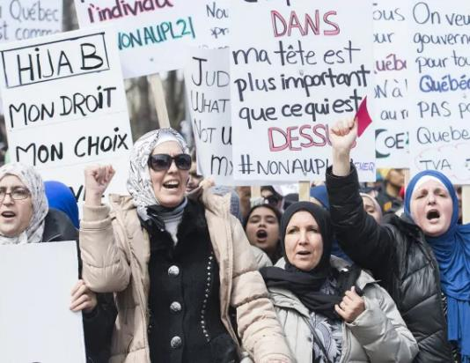
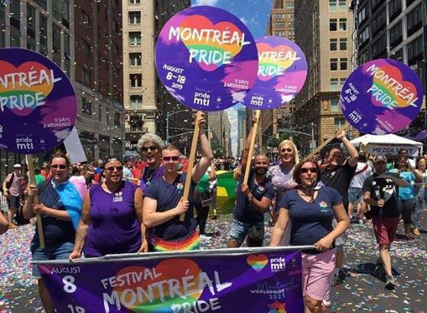
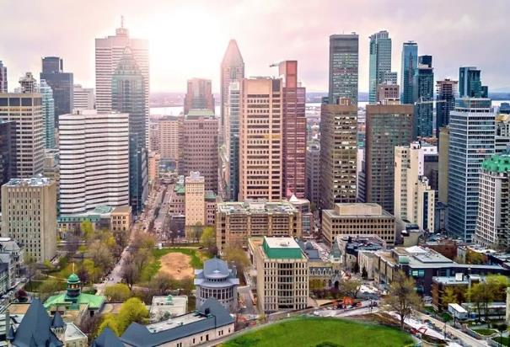
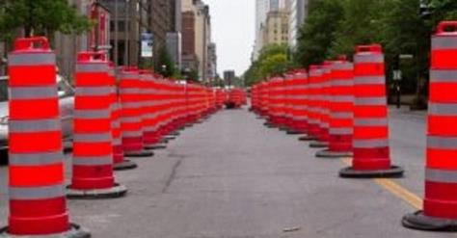
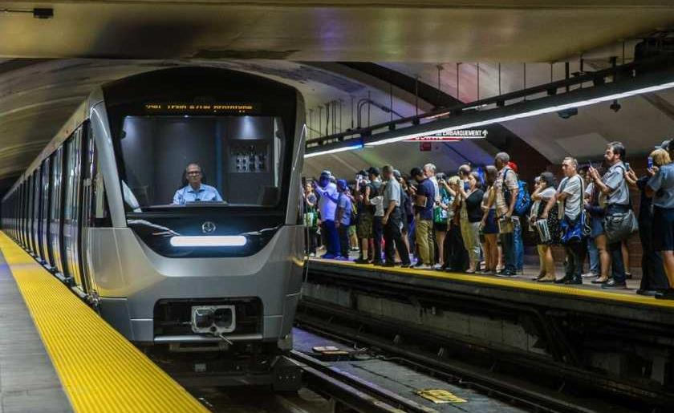
Life in Montreal

Slide 4
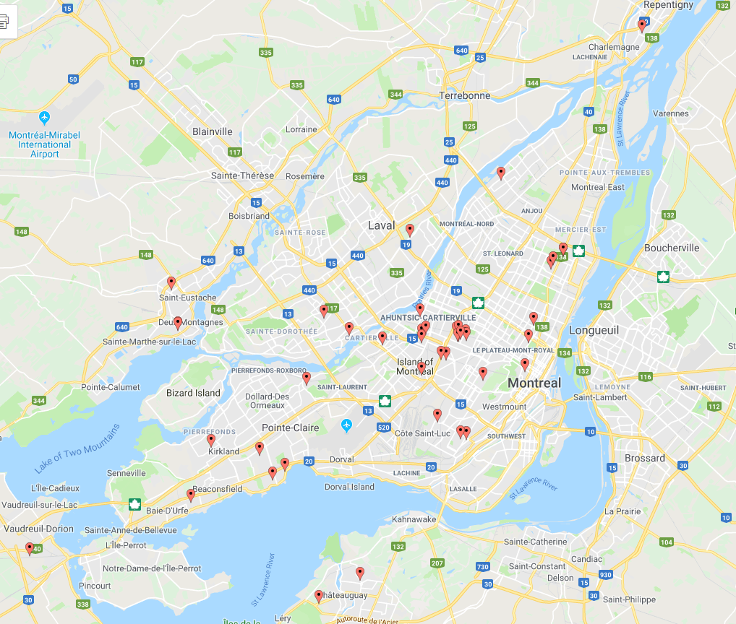
Geography
Navigation
Two dozen bridges
Conemaggedon
East Coast City
High transit
High density
4 million
Multilingual
66% French
14% English
4% Arabic
3% Spanish
15 – 45 min
35 – 65 min

Slide 5
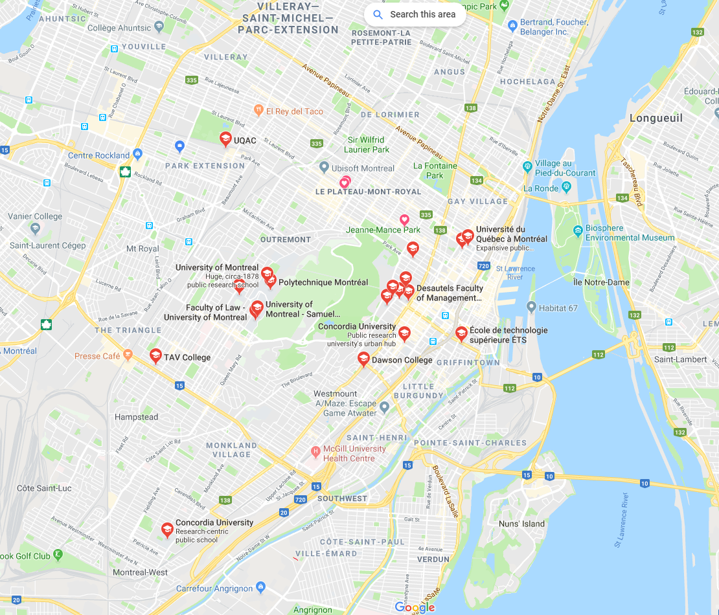
Geography
Universities
UQAM
U de M
McGill
Concordia
170,000 + Students
Home of…
LGBTQ
Aviation
High-Tech
Corruption

Slide 6
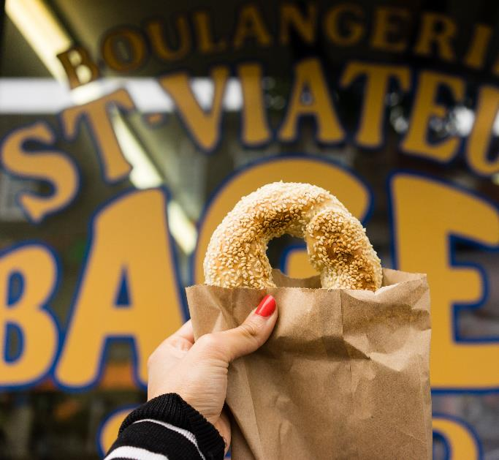
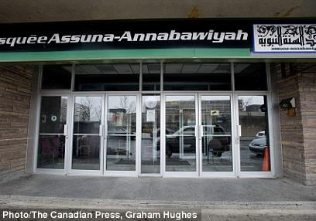
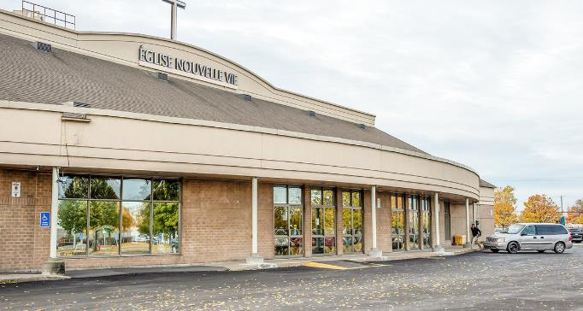
Religion in Montreal

Slide 7
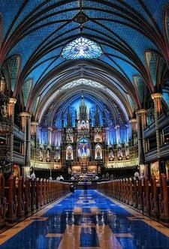
A Secular City Seeking Spirituality
A non-practicing city (Bill 21, closing churches)
A city of immigrants (150,000 Muslims)
One of the highest suicide rates in the Canada
Lowest rates of marriage, highest in cohabitation
Largest unreached people group in North America
Many open to spiritual conversations

Slide 8
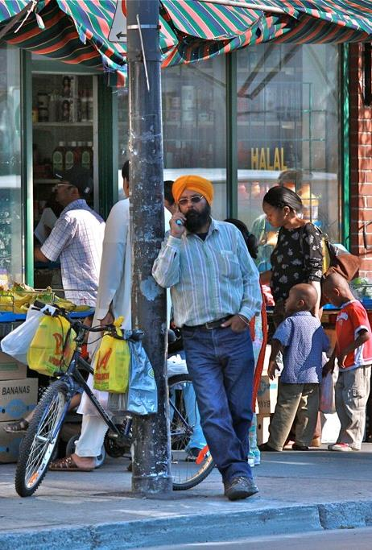
Parc-Extension
30,000 people in ½ a square mile
Around 2/3rd are immigrants
61% are visible minorities
35% have no diploma or degree
44% considered low income
75% rent their homes
11% can speak neither English or French

Slide 9
A Plan for Ascension (LCMS)
The Work the Lord has Given Us

Slide 10
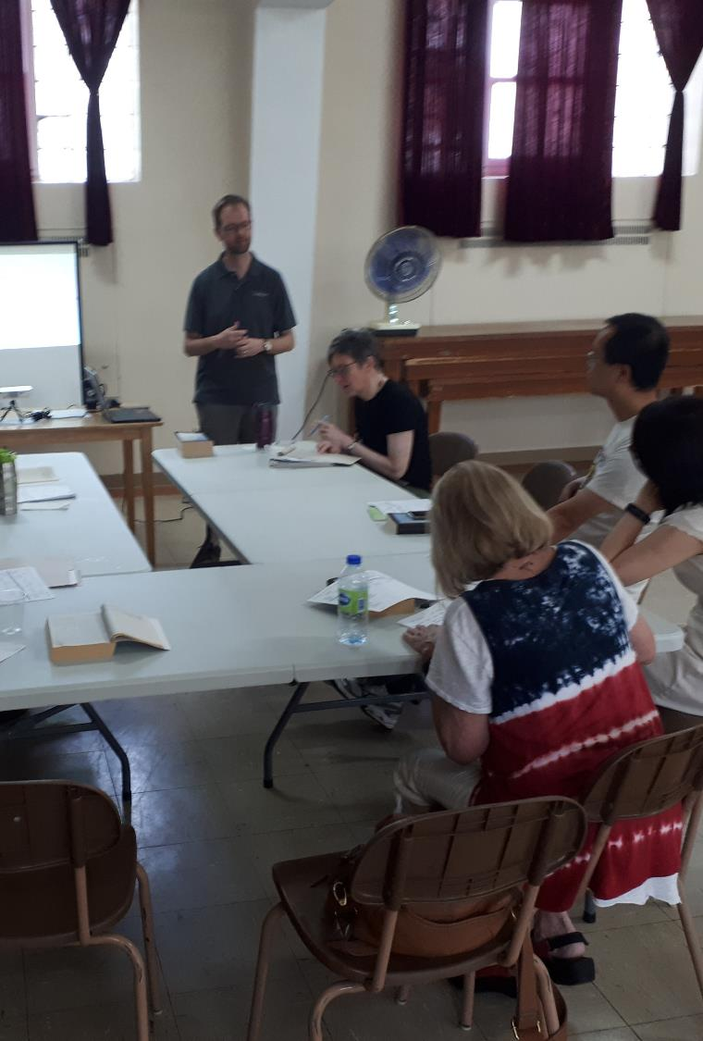
Our Mission Team
All members of Ascension invited, eight participated
“Kingdom of the Right” vs Council (Kingdom of the Left)
Meetings every other month, starting January
Brainstormed opportunities and challenges
Developed positions and goals
Identified mission/evangelism obstacles

Slide 11
Witness, Mercy, Life Together
Basis for Positions and Goals:
Spread the Gospel
Show Christ’s Mercy
Plant Lutheran Churches

Slide 12
Congregation’s Strengths
1) History of engaging the community surrounding Ascension, especially the variety of peoples that have come to Quebec and Montreal.
2) Congregational flexibility in adapting to changing circumstances, to a higher degree than is usually found in a congregation of its age. Willingness to explore ministry in other languages.
3) Good sized facility, maintained, centrally located within the Greater Montreal area, housing for a missionary and space for mission
4) Missionaries and pastors have linguistic gifts (French, English, Spanish, Chinese). Excellence in preaching is one of the mission’s strengths.

Slide 13
Congregation’s Weaknesses
1) Small and without a core of “wealthy donors” that enables other smaller congregations to be self-supporting
2) Montreal more of a Latin city than a typical Anglo North American city. Other church bodies have identified this unique characteristic as requiring greater effort than elsewhere.

Slide 14
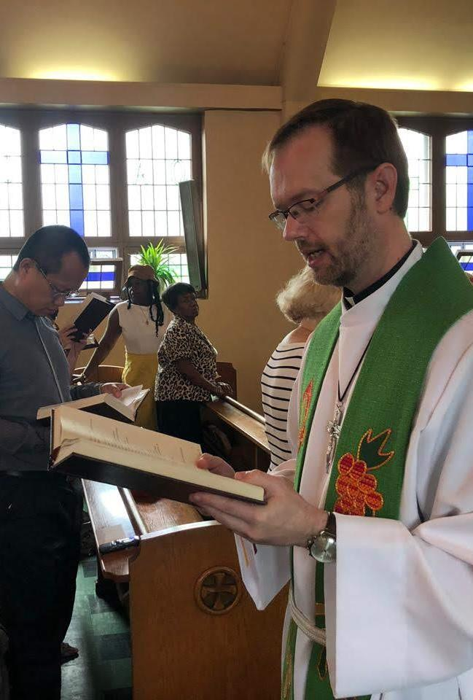
WITNESS
Strategic Position 1:
Establish Congregation(s)
Strategic Position 2:
Increase Capacity for Ministry

Slide 15
SP 1: Establish Congregation(s)
#1: INCREASE VISIBILITY
Logo (Jess Rosenwinkel)
Banners
New system needed
$1K CND project
Signage
High pedestrian traffic
Two “facilities”
$25K CND project
ASK: Funding

Slide 16
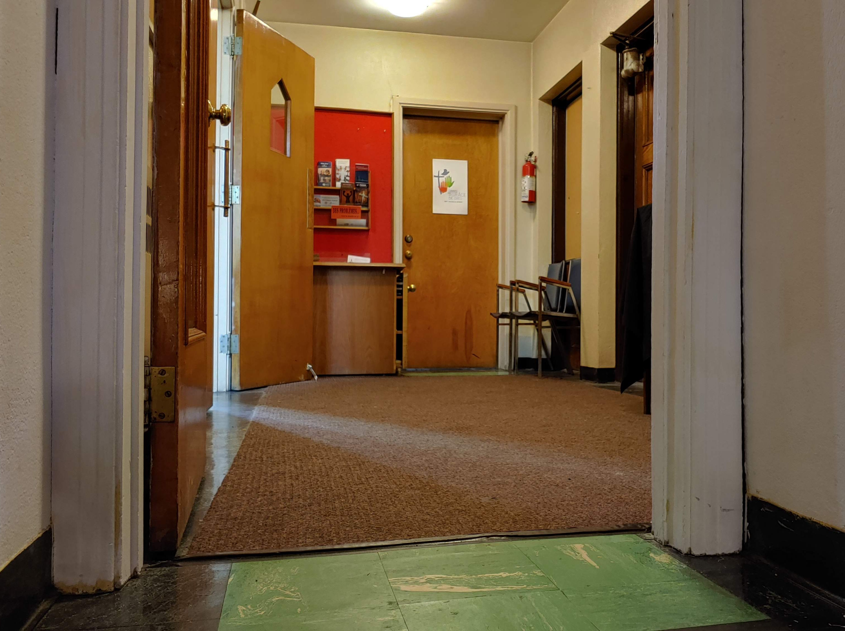
SP 1: Establish Congregation(s)
#2: EVALUATE FACILITY
Narthex Space
Handicap Issues
Children’s Space
Washroom Access
Outside Entrances
ASK: Funding/Time

Slide 17
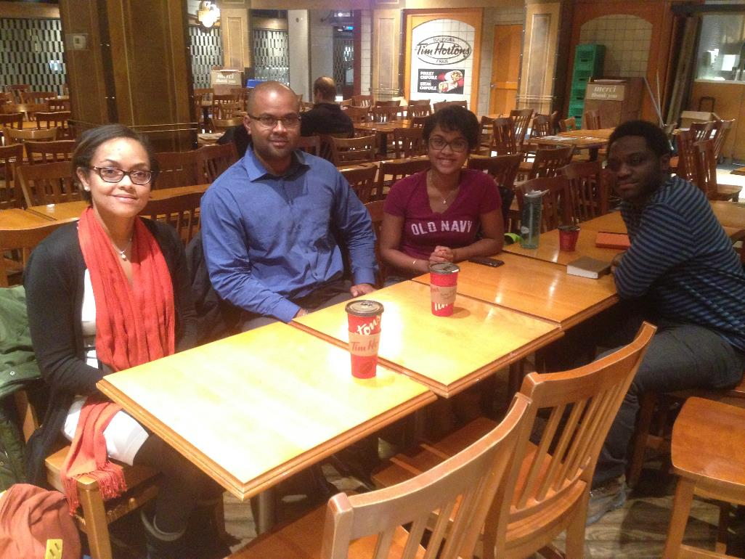
SP 1: Establish Congregation(s)
#3: STUDY OPPORTUNITIES
Geographic
Linguistic
Generational
Campus
ASK: Personnel

Slide 18
SP 1: Establish Congregation(s)
#4: INTERNET
CV Outreach
Waybase
Podcast
Website
Social Media
ASK: Personnel/Training

Slide 19
SP 1: Establish Congregation(s)
Active Ascension Membership
#5: NEW WORSHIP
Geographic
Linguistic
“Stretch Goal”
ASK: Personnel

Slide 20
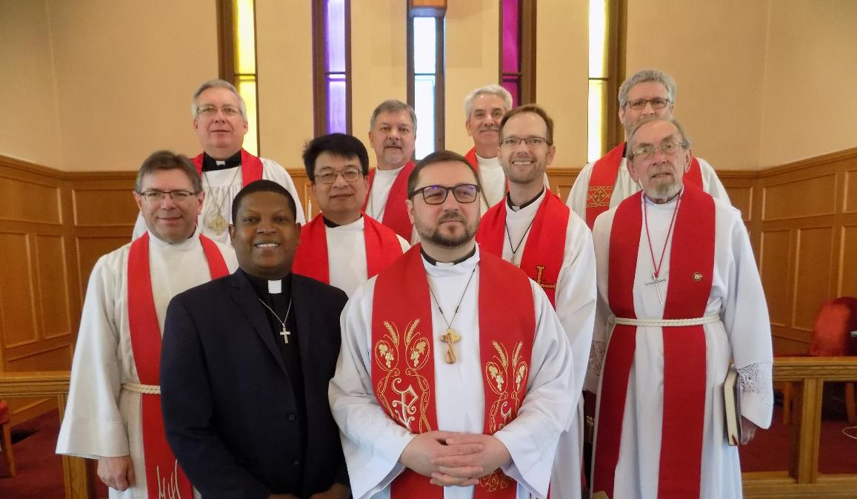
SP 2: Increase Capacity
#1: MISSIONARY
Alliance
NSM
ASK: Personnel / Partner

Slide 21
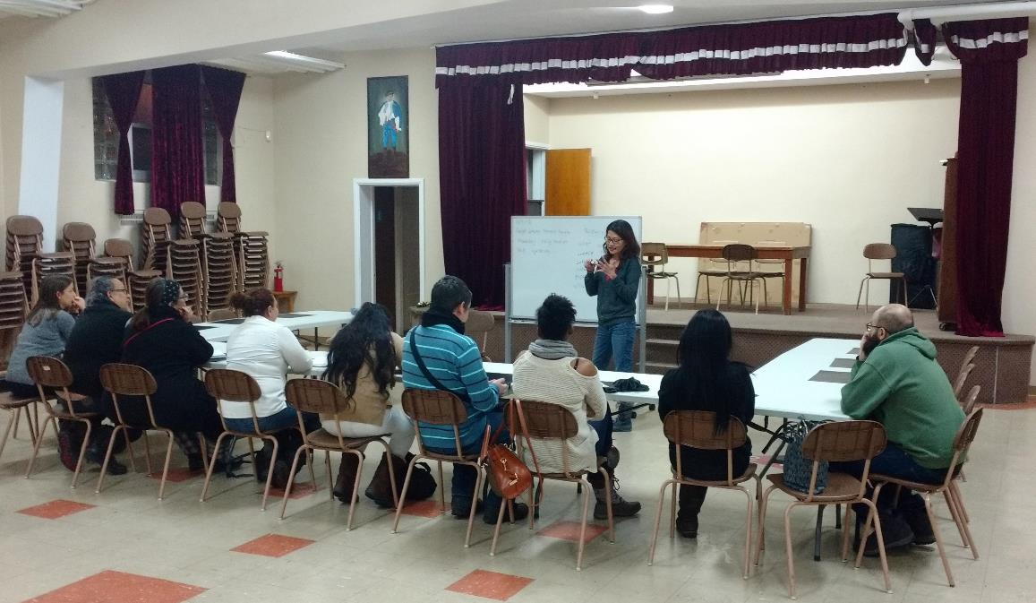
SP 2: Increase Capacity
#2: LAY PEOPLE
Training Needed
Mission Team
ASK: Personnel

Slide 22
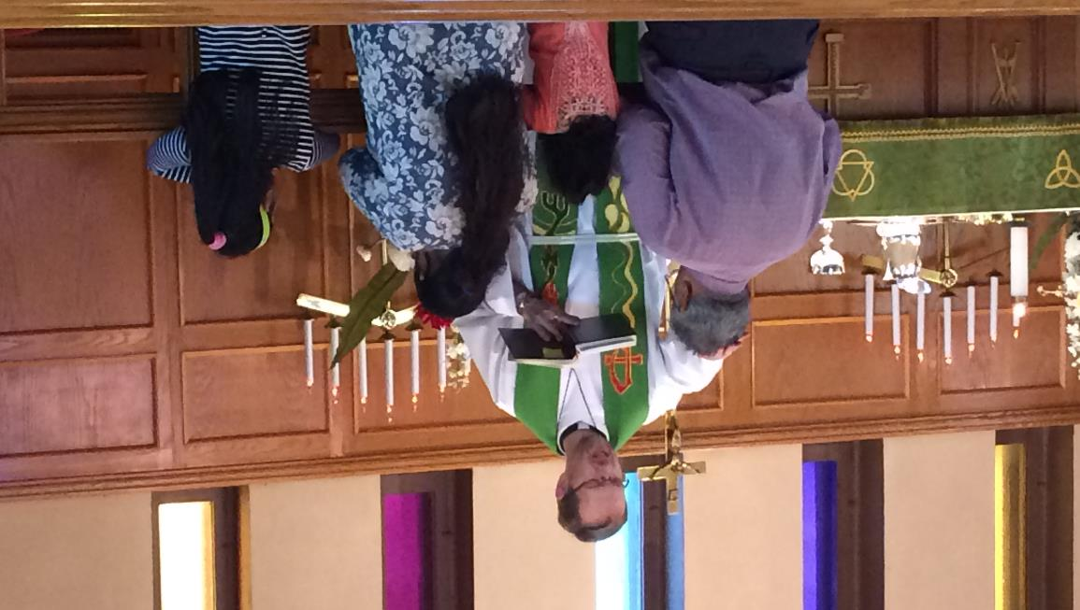
SP 2: Increase Capacity
#3: LOCAL LEADERS
“Stretch Goal”
Path to Ord.
ASK: Alliance

Slide 23
MERCY
Strategic Position 3:
Inside the Household of Faith
Strategic Position 4:
Outside the Household of Faith

Slide 24
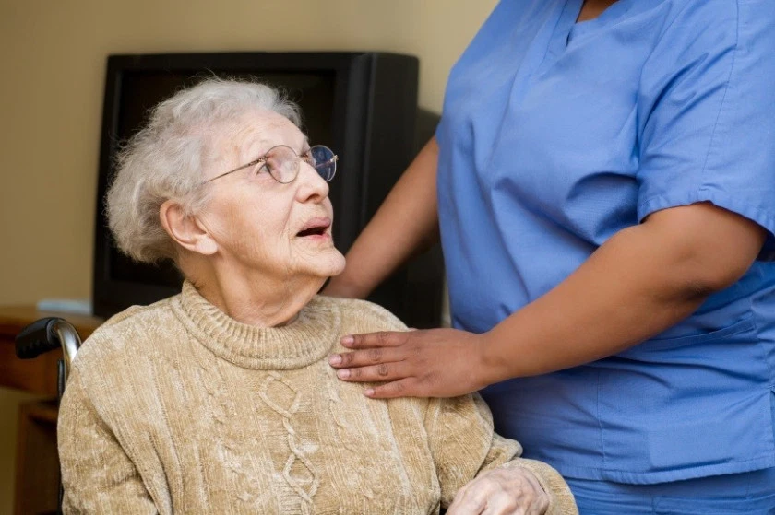
SP 3: Inside the Household of Faith
#1: Elder Care
Visits
Word and Sacrament
#2: Hardship Care
Community Chest
Legal Help
ASK: Prayers

Slide 25
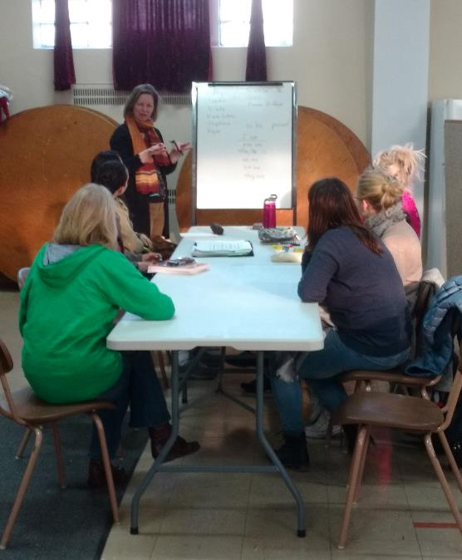
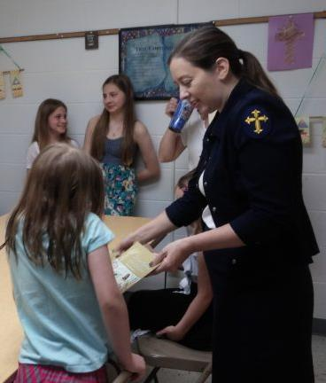
SP 3: Outside the Household of Faith
#1: New Arrivals
English Classes
Legal Assistance
#2: Deaconess
Locally trained
Intern
NSM
ASK: Personnel

Slide 26
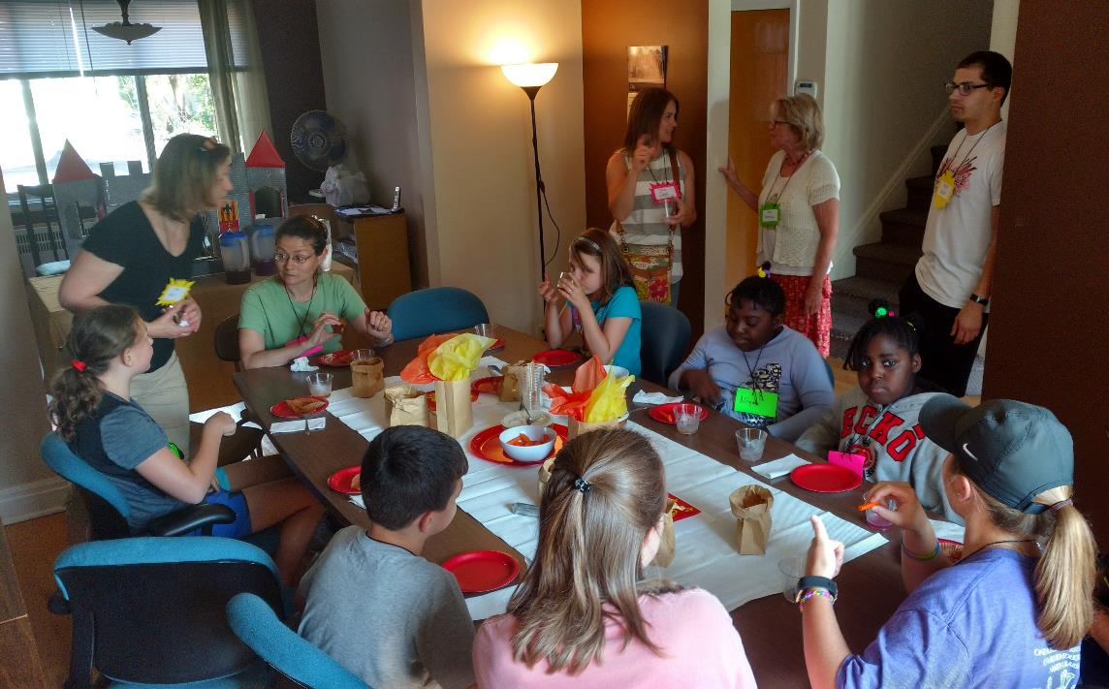
SP 3: Outside the Household of Faith
#3: Volunteers
Individuals
Builders
Designers
Summer vicars
Teams
Construction
Kids Camp
English
ASK: Volunteers

Slide 27
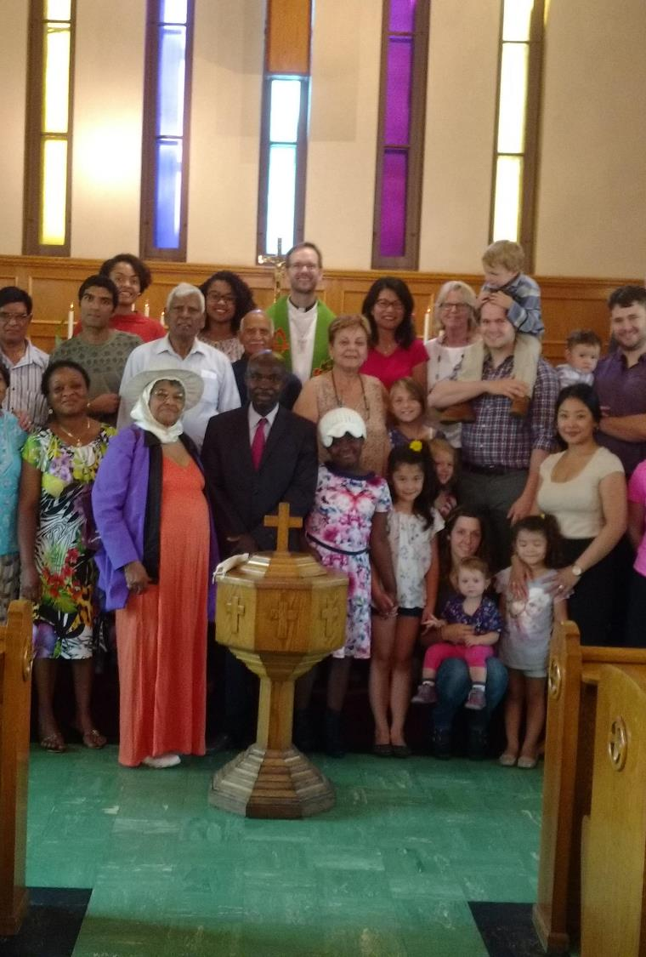
Life Together
Strategic Position 5:
Within Local Body of Christ
Strategic Position 6:
With FORO Partners

Slide 28
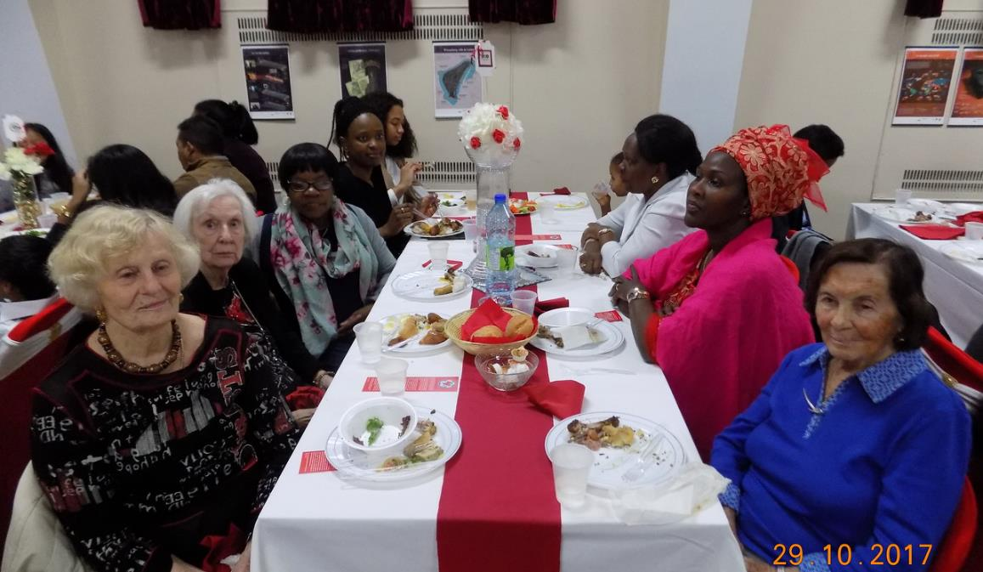
SP 5: Increase Local Ties
#1: Fellowship Activities
Four fellowship meals each year
Game nights
ASK: Prayers

Slide 29
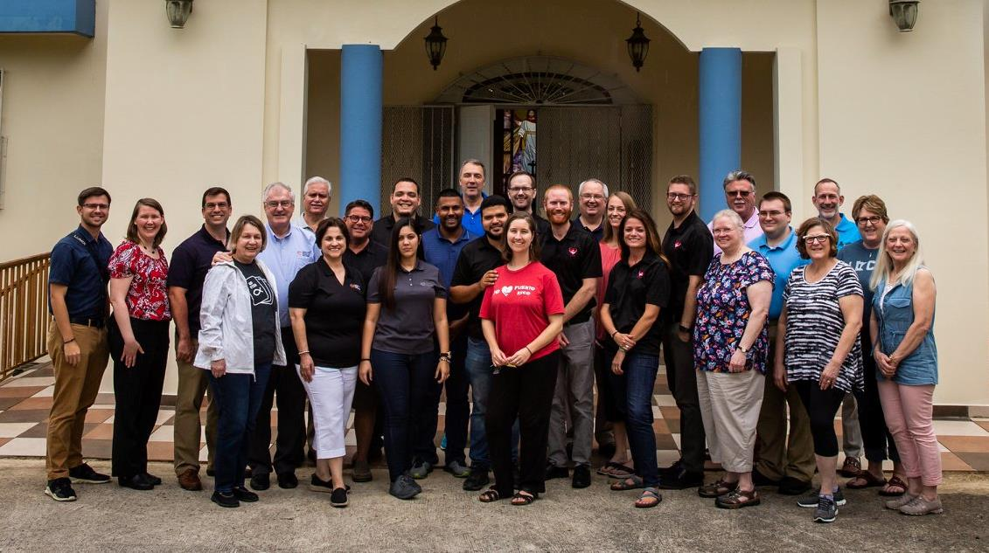
SP 6: FORO Partners
#1: Partners
One annual meeting
Request to visit partner churches and build ties
Newsletter
ASK: Prayers – and Talk About This Mission!

Slide 30
Discussion

